Slide 1
Epidemiology and Big Data Mixed Models 1: Introduction to Multilevel Models
Rebecca Stellato

Slide 2
Relevant Course Objectives
At the end of the course, the student will:
know when to apply a mixed model in practice
be able to perform mixed model analyses using statistical software (R)

Slide 3
Objectives for this week
At the end of this week, the student will:
recognize multi-level and longitudinal study designs
be able to explain the difference between fixed and random effects, and know when to use random effects
know when to apply a linear mixed model
be able to perform linear mixed models using R

Slide 4
Overview Lecture 1: Multilevel Modelling
Introduction to multilevel data
Example: multilevel data (children within schools)
The problem, and some possible solutions
The mixed model solution
Adding random effects (random intercept, random slope)
Adding fixed effects (school- and child-level) to the model
Interpretation of mixed models
Summary

Slide 5
Examples of multilevel data
Effect of school environment on exam results
Design: hierarchical, where the examination results of a random sample of students within a random sample of schools are compared
Influence of race and sex on fetal heartbeat during pregnancy
Design: repeated measurements on different gestational ages during pregnancy, where the gestational ages were not the same for all women
Multi-center hypertension trial
Design: hierarchical, with 193 patients in 27 centers, DBP measured 5 times per patient over the course of several weeks

Slide 6
Characteristics of multilevel data
Hierarchical structure of data
children within (classrooms within) schools
patients within centers
measurements within patients
Variation at all levels
“Units” within a level expected to be correlated
Variables can be measured at different levels
Level 2:
type of school (mixed vs. single-gender)
university vs. community hospital
Level 1:
reading ability of child at intake
gender of patient

Slide 7
Example: London Schools
Data collected by Goldstein, Rasbash, et al (1993) on 4059 children in 65 schools in Inner London.
Question: is examination achievement related to intake achievement level, pupil gender, school type and exam achievement of school (averaged over all pupils)?
Subquestion: do girls do better at a mixed or all-girls’ school?

Slide 8
Example: London Schools
Variables in dataset:
School ID
Student ID
Normalised exam score (outcome variable)
Standardised LR test score
Student gender
School gender
School average of intake score
Student level Verbal Reasoning (VR) score category at intake
Category of students’ intake score (averaged)

Slide 9
London Schools
school | # boys | # children | school | # boys | # children
1 | 45 | 73 | 13 | 26 | 64
2 | 0 | 55 | 14 | 92 | 198
3 | 29 | 52 | 15 | 47 | 91
4 | 45 | 79 | 16 | 0 | 88
5 | 16 | 35 | 17 | 31 | 126
6 | 0 | 80 | 18 | 0 | 120
7 | 0 | 88 | 19 | 33 | 55
8 | 0 | 102 | 20 | 21 | 39
9 | 21 | 34 | 21 | 0 | 73
10 | 31 | 50 | 22 | 48 | 90
11 | 62 | 62 | . | . | .
12 | 23 | 47 | . | . | .
 |  |  | . | . | .

Slide 10
London Schools

Slide 11
London Schools
How to analyze relation between exam score and LRT score?
linear regression, mean exam per school vs mean LRT (“aggregated data”)
linear regression, all schools together (“disaggregated data”)
linear regression per school
linear regression, all schools together, regression with main effect and interactions to allow for different intercepts and slopes
Linear Mixed Model

Slide 12
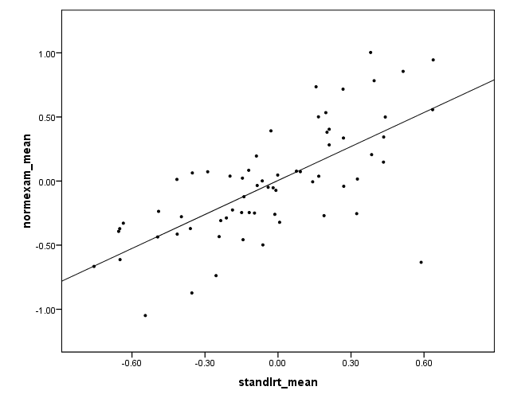
London Schools:
1. linear regression, aggregated mean exam vs mean LRT

Slide 13
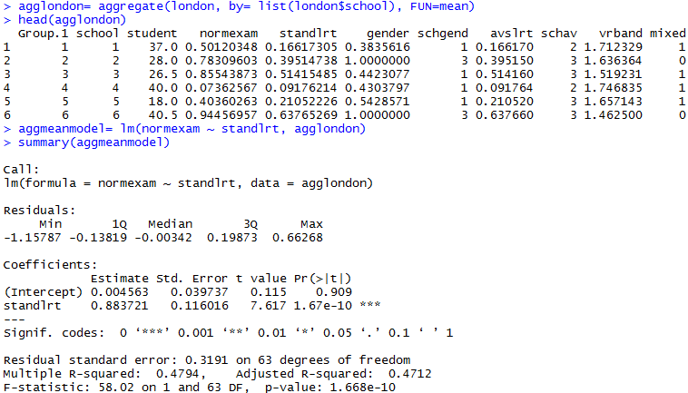
London Schools:
1. linear regression, aggregated mean exam vs mean LRT
estimate for intercept: 0.005 (se 0.040)
estimate for slope: 0.884 (se 0.116)

Slide 14
London Schools:
1. linear regression, aggregated mean exam vs mean LRT
Disadvantages:
every school (regardless of sample size) given equal weight
N = 65
school-level variables possible, but not child-level variables
we can only make inference at school level, not child-level
possibility of “ecological fallacy”

Slide 15
London Schools
2. linear regression, all schools together

Slide 16
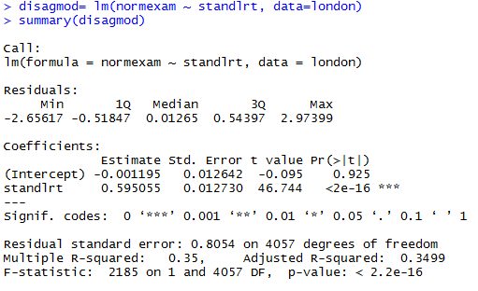
London Schools
2. linear regression, all schools together
estimate for intercept: - 0.001 (se 0.013)
estimate for slope: 0.595 (se 0.013)

Slide 17
London Schools:
2. linear regression, all schools together
Disadvantages:
inflates sample size, especially for level-2 variables
SE’s of level-2 variables tend to be underestimated → p-values too small, CI’s too narrow (type I error inflated)
SE’s of level-1 variables may be over- or underestimated
ignore correlated residuals (correlation of children within schools)

Slide 18
London Schools:
2. linear regression, all schools together

Slide 19
London Schools:
2. linear regression, all schools together

Slide 20
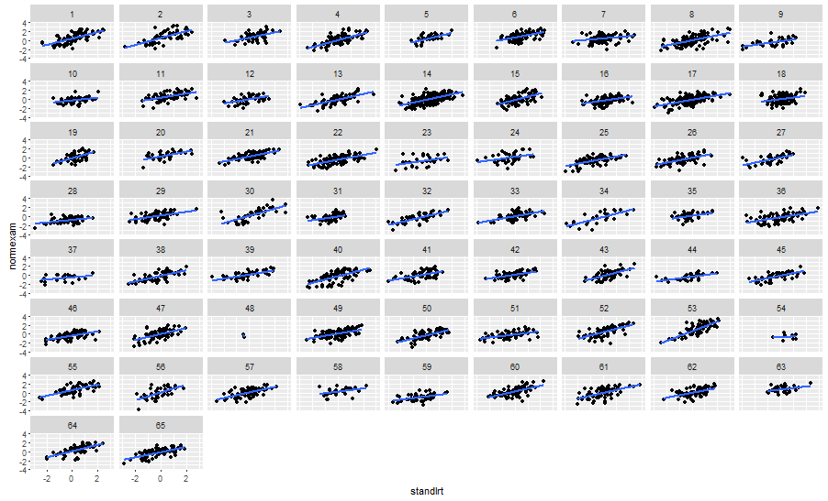
London Schools
3. linear regression per school

Slide 21
London Schools
3. linear regression per school
School Intercept slope
1 0.383330189 0.70934058
2 0.482275275 0.76128749
3 0.557750538 0.57898548
4 0.003753722 0.76144638
5 0.260443999 0.68001660
6 0.603206568 0.53534316
.............
summary intercepts:
mean = -0.068; sd = 0.519; sem = 0.064
summary slopes:
mean = 0.425; sd = 0.939; sem = 0.116

Slide 22
London Schools
3. linear regression per school
Disadvantages:
65 different regressions, how to combine the results?
mean slope: every school has equal weight
standard error of parameter estimate correct?
child-level variables possible, but not school-level variables

Slide 23
London Schools
4. all schools together, main effects and interactions
Advantage over previous analysis:
now we can include both child- and school-level variables
residuals probably normally distributed (with constant variance?) around individual lines
Disadvantages:
We wanted 1 intercept and 1 slope for LRT, but:
65 schools, so 1 reference category and 64 estimates for intercepts (main effects per school) + 64 estimates for interactions (slopes per school)!
Which school is the reference?
We can’t generalize beyond these 65 schools
This model uses 128 extra df for all those intercepts & slopes

Slide 24
London Schools: models so far
Model | overall/fixed slope LRT | s.e.
1. aggregated data | 0.884 | 0.116
2. disaggregated data | 0.595 | 0.013
3. regr. per school | 0.425 | 0.116
4. school*LRT interactions | ?? | ??

Slide 25
London Schools
5. Mixed Models
Advantages:
sample size correct, account for correlation of children within schools
so: correct SE’s/p-values/CI’s
no need for 64 main effects and interactions
differences between schools captured one or more ‘variance components’
both child-level and school-level variables simultaneously
so: inference for both children and schools
interactions between child- and school-level variables possible
examine variation at different levels
models work well in presence of missing outcomes (longitudinal)

Slide 26
Mixed Models
Mixed models made up of
fixed effects
random effects
Sometimes (inaccurately) called “random effects models”
Also sometimes called “random coefficient” models
Some variables (or: their coefficients) can be included as both “fixed” (of interest) and “random” (random variation across the level-2 units)

Slide 27
Mixed Models: what is a “fixed effect”?
Fixed effect: variable of interest
overall intercept (not really of interest)
overall slope for LRT (to help make predictions of exam performance)
other fixed effects of interest:
gender (difference between boys and girls?)
type of school (boys’, girls’, mixed)
“achievement level” of school
...

Slide 28
Mixed Models: what is a “random effect”?
A random intercept per school allows schools to have different intercepts
A random effect for LRT per school allows the effect of LRT on exam score to differ per school (“random slope for LRT” = different slope for exam-LRT relation for each school)
Random effect (“slope”) can also be for a categorical variable
difference between boys and girls on exam score could differ per school
treatment effect on an outcome can be thought to vary per center in a multi-center study
All variables of interest are added as fixed
Depending on theory, none/one/some fixed variables may also be modelled as random

Slide 29
Mixed Models: what is a “random effect”?
Why “random effect”?
Schools are random sample of all Inner London schools
intercepts (and LRT slopes) from these schools are a random sample from all possible intercepts and slopes
intercepts (and LRT slopes?) differ from one another, but
interest not in estimating the intercept and slope per school, thus
sufficient to estimate the variances of the intercepts and slopes
intercepts (and slopes) thought to come from normal distributions with mean 0 and variances σ²_{υ0} and σ²_{υ1} , and covariance σ_{υ01}
in this way we only have to estimate 3 extra parameters, not 128

Slide 30
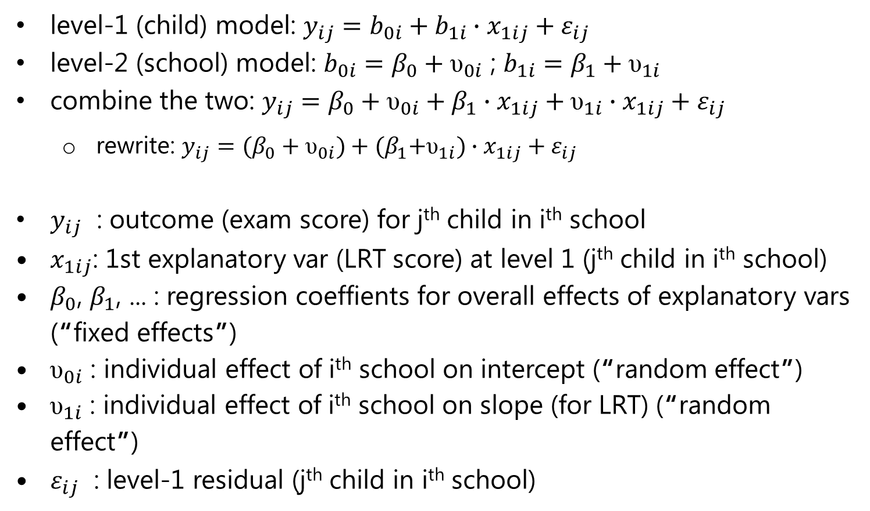
Interlude: some notation
level-1 (child) model: $y_{ij}=b_{0i}+b_{1i}∙x_{1ij}+ε_{ij}$
level-2 (school) model: $b_{0i}=β_{0}+{\text{υ}}_{0i}$ ; $b_{1i}=β_{1}+{\text{υ}}_{1i}$
combine the two: $y_{ij}=β_{0}+{\text{υ}}_{0i}+β_{1}∙x_{1ij}+{\text{υ}}_{1i}∙x_{1ij}+ε_{ij}$
rewrite: $y_{ij}=(β_{0}+{\text{υ}}_{0i})+{(β}_{1}+{\text{υ}}_{1i})∙x_{1ij}+ε_{ij}$
$y_{ij}$ : outcome (exam score) for j^{th} child in i^{th} school
$x_{1ij}$: 1st explanatory var (LRT score) at level 1 (j^{th} child in i^{th} school)
$β_{0}$, $β_{1}$, ... : regression coeffients for overall effects of explanatory vars (“fixed effects”)
${\text{υ}}_{0i}$ : individual effect of i^{th} school on intercept (“random effect”)
${\text{υ}}_{1i}$ : individual effect of i^{th} school on slope (for LRT) (“random effect”)
$ε_{ij}$ : level-1 residual (j^{th} child in i^{th} school)

Slide 31
Mixed Models: what is a “random effect”?
Random intercept only:
Random intercept + random slope:

Slide 32

London Schools
$$y_{1j}=β_{0}+β_{1}X_{11j}+ε_{1j}$$

Slide 33

London Schools
$$y_{1j}=β_{0}+_{01}+β_{1}X_{11j}+ε_{1j}$$
$$y_{2j}=β_{0}+_{02}+β_{1}X_{12j}+ε_{2j}$$
$$y_{ij}=β_{0}+_{0i}+β_{1}X_{1ij}+ε_{ij}$$

Slide 34

London Schools
$$y_{1j}=β_{0}+_{01}+β_{1}X_{11j}+_{11}X_{11j}+ε_{1j}$$
$$y_{2j}=β_{0}+_{02}+β_{1}X_{12j}+_{12}X_{12j}+ε_{2j}$$
$$y_{ij}=β_{0}+_{0i}+β_{1}X_{1ij}+_{1i}X_{1ij}+ε_{ij}$$

Slide 35
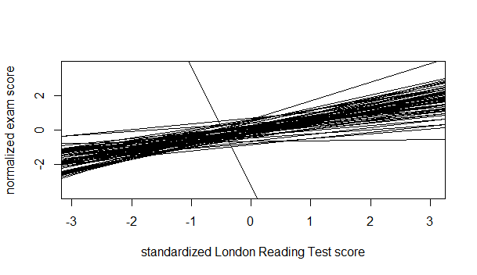
London Schools
Graph per school (“spaghetti plot”):

Slide 36
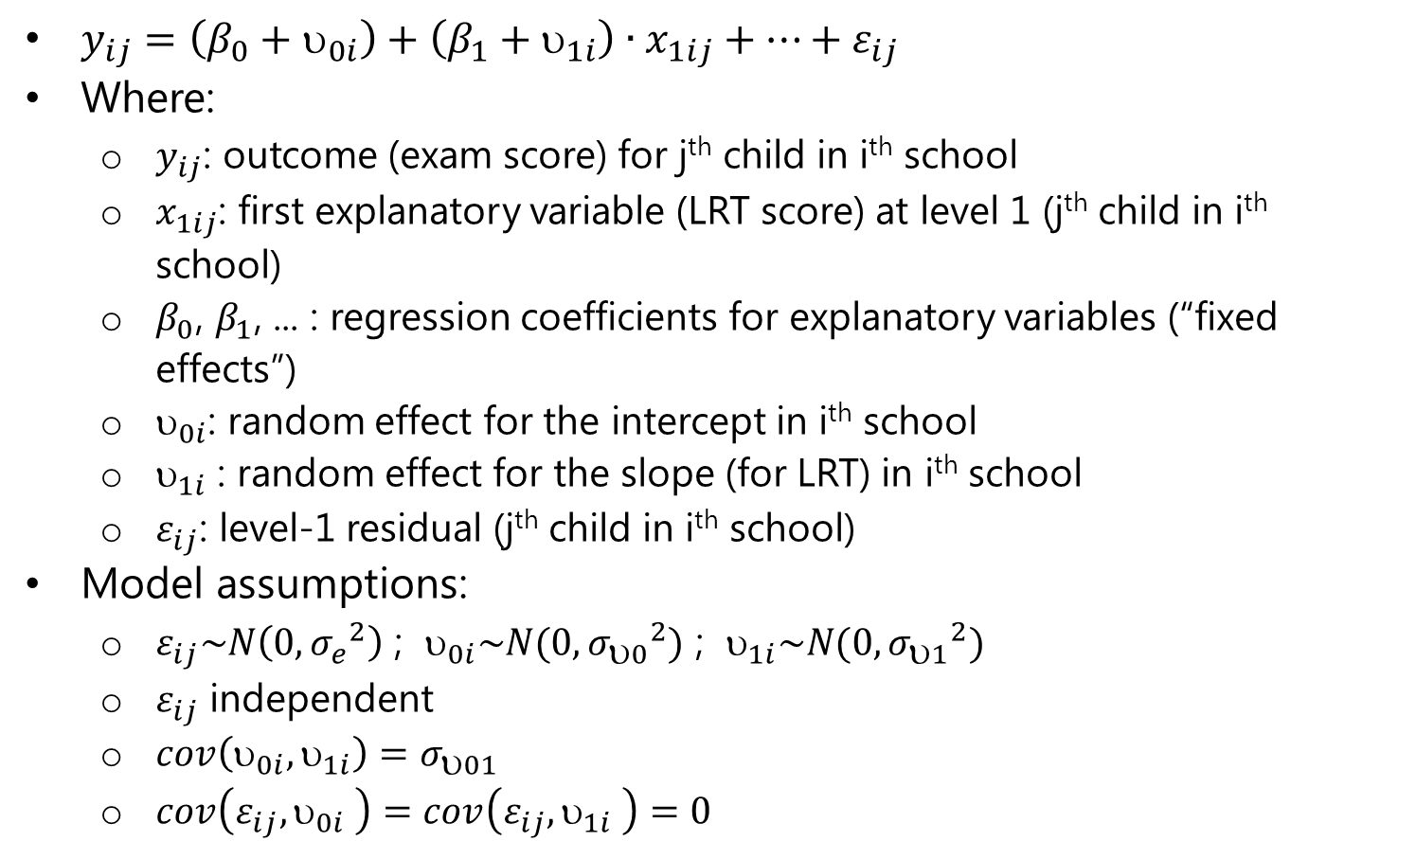
Mixed Models: the model
$y_{ij}=\left(β_{0}+υ_{0i}\right)+\left(β_{1}+υ_{1i}\right)∙x_{1ij}+⋯+ε_{ij}$
Where:
$y_{ij}$: outcome (exam score) for j^{th} child in i^{th} school
$x_{1ij}$: first explanatory variable (LRT score) at level 1 (j^{th} child in i^{th} school)
$β_{0}$, $β_{1}$, ... : regression coefficients for explanatory variables (“fixed effects”)
$_{0i}$: random effect for the intercept in i^{th} school
$_{1i}$ : random effect for the slope (for LRT) in i^{th} school
$ε_{ij}$: level-1 residual (j^{th} child in i^{th} school)
Model assumptions:
$ε_{ij}\sim N\left(0,{σ_{e}}^{2}\right)$ ; $_{0i}\sim N(0,{σ_{υ0}}^{2})$ ; $_{1i}\sim N(0,{σ_{υ1}}^{2})$
$ε_{ij}$ independent
$cov\left(υ_{0i},υ_{1i}\right)=σ_{υ01}$
$cov\left(ε_{ij},υ_{0i} \right)=cov\left(ε_{ij},υ_{1i} \right)=0$

Slide 37
Mixed models in R
Two packages used most frequently
Package nlme
lme() for Gaussian models
gls() function for models with correlated errors
approximate (Wald) CI’s via intervals() function in same package
Package lme4
lmer() for Gaussian models
glmer() for generalized linear mixed models (day 2)
“profile likelihood” CI’s via confint()
See information on Blackboard

Slide 38
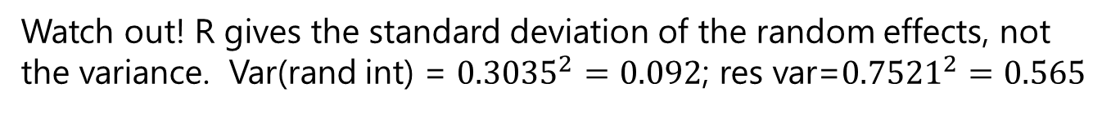
London Schools: mixed model
random intercept only
> sch.lme.1 <- lme(fixed=normexam~standlrt, random=~1 | school, data=london, method="ML")
> summary(sch.lme.1)
Linear mixed-effects model fit by maximum likelihood
Data: london
AIC BIC logLik
9365.213 9390.447 -4678.606
Random effects:
Formula: ~1 | school
(Intercept) Residual
StdDev: 0.3035269 0.7521481
“fixed=” is optional; you could also just use:
lme(normexam~standlrt, random=~1|school, data=london, method="ML")
Watch out! R gives the standard deviation of the random effects, not the variance. Var(rand int) = ${0.3035}^{2}=0.092$; res var=${0.7521}^{2}=0.565$

Slide 39
London Schools: mixed model
random intercept only
Fixed effects: normexam ~ standlrt
Value Std.Error DF t-value p-value
(Intercept) 0.0023871 0.04003241 3993 0.05963 0.9525
standlrt 0.5633697 0.01246844 3993 45.18366 0.0000
Correlation:
(Intr)
standlrt 0.008
Standardized Within-Group Residuals:
Min Q1 Med Q3 Max
-3.7161719 -0.6304245 0.0286690 0.6844298 3.2680306
Number of Observations: 4059
Number of Groups: 65

Slide 40
London Schools: mixed model
simplest model: only random intercept
Estimate for fixed intercept is 0.0024
(est.) mean exam score for a child with standardized LRT = 0 (mean)
Estimate for fixed slope is 0.563
for every unit (1 sd) increase in LRT score, the exam score increases on average by 0.563 sd (= units of exam score, because normalized)
Estimate for random intercept (between-school) variance is 0.092
Estimate for within-school (residual) variance is 0.566
In this model, more unexplained variance within than between schools
Notes:
Note again: SPSS variance, R standard error. Need to change??

Slide 41
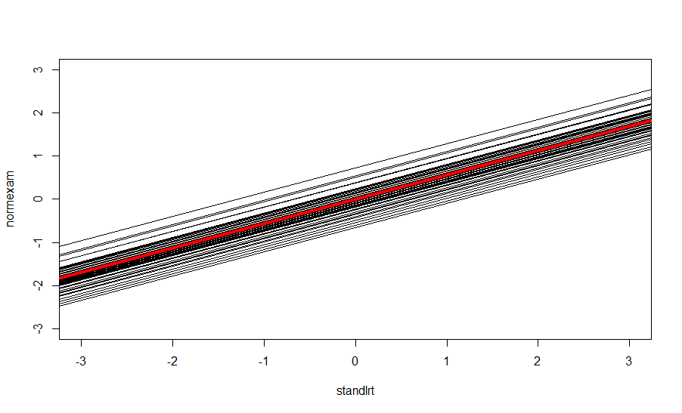
London Schools: mixed model
simplest model: only random intercept
Fitted model
Notes:
Red Line is fixed model, separate black lines are individual schools

Slide 42
London Schools: mixed model
random intercept + random slope
> sch.lme.2 <- lme(fixed=normexam~standlrt, random=~standlrt | school, data=london, method="ML")
> summary(sch.lme.2)
Linear mixed-effects model fit by maximum likelihood
Data: london
AIC BIC logLik
9328.84 9366.693 -4658.42
Random effects:
Formula: ~standlrt | school
Structure: General positive-definite, Log-Cholesky parametrization
StdDev Corr
(Intercept) 0.3007313 (Intr)
standlrt 0.1205753 0.497
Residual 0.7440777

Slide 43
London Schools: mixed model
random intercept + random slope
Fixed effects: normexam ~ standlrt
Value Std.Error DF t-value p-value
(Intercept) -0.0115074 0.03979173 3993 -0.289192 0.7724
standlrt 0.5567279 0.01994287 3993 27.916142 0.0000
Correlation:
(Intr)
standlrt 0.365
Standardized Within-Group Residuals:
Min Q1 Med Q3 Max
-3.83123233 -0.63247485 0.03404163 0.68320636 3.45617450
Number of Observations: 4059
Number of Groups: 65

Slide 44
London Schools: mixed model
random intercept + random slope
Interpreting the model:
Fixed intercept = -0.01: average exam score when stdLRT = 0 (so for a child with an average LRT score)
Fixed effect LRT = 0.56: for two children who differ by 1 SD in LRT score, the exam score will be (on average) 0.56 SD higher for the child with the higher LRT score
SD of random intercepts (0.30) and slopes (0.12) is much smaller than residual variance (0.74) - more variance within than between schools
Correlation intercept-slope (0.497) usually not interesting, but:
schools with higher mean exam score when stdLRT=0 (mean LRT) tend to have higher slope

Slide 45
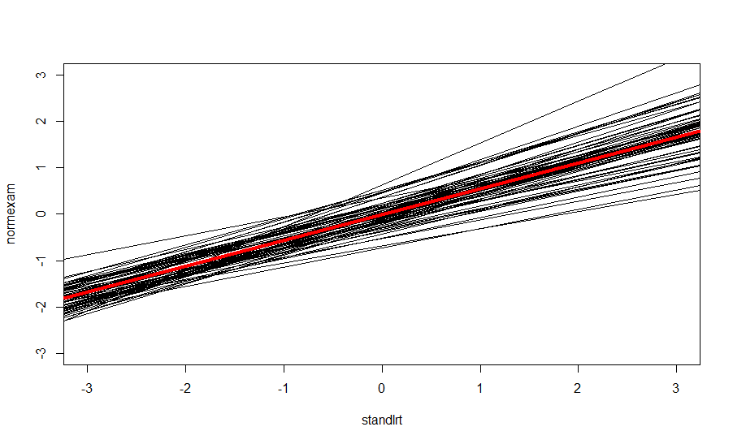
London Schools: mixed model
random intercept + random slope
Fitted model

Slide 46
London Schools: comparing right & wrong models
Model | overall/fixed slope LRT | s.e.
1. aggregated data | 0.884 | 0.116
2. disaggregated data | 0.595 | 0.013
3. regr. per school | 0.425 | 0.116
4. school*LRT interactions | ?? | ??
5a. mixed model (random intercept) 5b. mixed model (random int + random slope LRT) | 0.563 0.557 | 0.012 0.020

Slide 47
London Schools data
Aside: coding of categorical variables
Gender: 0=boy, 1=girl
Schavg (school average of intake score): 1=low, 2=mid, 3=high
Schgend: 1= mixed school, 2=boys’ school, 3=girls’ school

Slide 48
London Schools:
adding a (fixed) child-level covariate
> sch.lme.3 <- lme(fixed=normexam~standlrt + factor(gender), random=~standlrt | school, data=london, method="ML")
> summary(sch.lme.3)
Linear mixed-effects model fit by maximum likelihood
Data: london
AIC BIC logLik
9301.358 9345.518 -4643.679
Random effects:
Formula: ~standlrt | school
Structure: General positive-definite, Log-Cholesky parametrization
StdDev Corr
(Intercept) 0.2936242 (Intr)
standlrt 0.1212575 0.533
Residual 0.7416710
Fixed effects: normexam ~ standlrt + factor(gender)
Value Std.Error DF t-value p-value
(Intercept) -0.1117670 0.04305229 3992 -2.596075 0.0095
standlrt 0.5529634 0.01998634 3992 27.667060 0.0000
factor(gender)1 0.1757988 0.03225659 3992 5.450011 0.0000
Notes:
Note that gender=1 is girls, so girls compared to boys score higher

Slide 49
London Schools:
adding a child-level covariate
On average, girls score 0.176 SD higher on exam than boys (holding stdLRT constant)

Slide 50
London Schools
adding (fixed) school-level covariates
> sch.lme.4 <- lme(normexam~standlrt + factor(gender)+ factor(schgend) + factor(schav),
random=~standlrt | school, data=london, method="ML")
> summary(sch.lme.4)
Random effects:
Formula: ~standlrt | school
Structure: General positive-definite, Log-Cholesky parametrization
StdDev Corr
(Intercept) 0.2660309 (Intr)
standlrt 0.1212542 0.499
Residual 0.7417279
Fixed effects: normexam ~ standlrt + factor(gender) + factor(schgend) + factor(schav)
Value Std.Error DF t-value p-value
(Intercept) -0.2647657 0.08159434 3992 -3.244902 0.0012
standlrt 0.5515520 0.02006950 3992 27.482097 0.0000
factor(gender)1 0.1671313 0.03385088 3992 4.937282 0.0000
factor(schgend)2 0.1869684 0.09777600 60 1.912211 0.0606
factor(schgend)3 0.1570156 0.07780641 60 2.018029 0.0481
factor(schav)2 0.0668879 0.08534936 60 0.783696 0.4363
factor(schav)3 0.1742650 0.09876108 60 1.764511 0.0827

Slide 51
London Schools:
Adding child- and school-level covariates

Slide 52
London Schools: conclusions (so far)
The reading score is a significant predictor of exam score
for every 1 SD higher on reading score, average increase of 0.552 SD on exam score
Boys do significantly worse than girls on exam
boys score, on average, 0.167 SD lower on exam than girls
School “level” (average exam score) does not appear to be predictive of exam score
School gender may be predictive
average exam score at girls’ schools is 0.157 SD higher than at mixed schools
average exam score at boys’ schools is 0.174 SD higher than at mixed schools
Note: these conclusions are based on the “Wald” p-values and are not necessarily to be trusted!

Slide 53
London Schools: conclusions (so far)
Because the LRT score has been centered, the estimate for the intercept (-0.265) is the estimated average (normalized) exam score for:
a boy (ref) with
avg LRT score from
a school with low average score (ref) and
mixed school (ref)
The residual variance is 0.550, much larger than the variances for the random intercept (0.071) and random slope (0.015), indicating more variation within schools than between.
Adding child- and school-level covariates explains some of the variance between schools (variance intercepts 0.09 → 0.07)

Slide 54
London Schools: still to do
We’ve made model assumptions, need to check them!
distribution of residuals
distribution of random effects (?)
How to choose among models?
How to answer subquestion (does gender of school have influence on effect of gender of pupil?)

Slide 55
Multilevel modelling, summary
Account for correlation of measurements at different levels
children within schools, measurements within patients
Allow us to include variables measured at different levels
child’s gender, school’s achievement or SES level
We can model variation at different levels
more variation within than between schools
Longitudinal data is a specific example of multi-level data
lecture 2: mixed models for longitudinal data
How to build models, check assumptions?
lecture 3: technical issues in multilevel/longitudinal modelling
Outcomes don’t have to be continuous
lecture 4: models for Poisson, binomial and survival data

